Slide 1
Εφαρμογή DCCA στο ADNI
Γιώργος Αϊδίνης

Slide 2
Understanding the method
Study our Dataset
Perform Linear Regression, keep residuals to remove any unwanted effect
Train DCCA Neural Network &Transform features through DCCA NN
Perform Classification using various algorithms
Experiment with data analysis techniques to process the data (OPNMF, MCA, FAMD) and then use DCCA
Conclusions

Slide 3
Study our Dataset

Slide 4
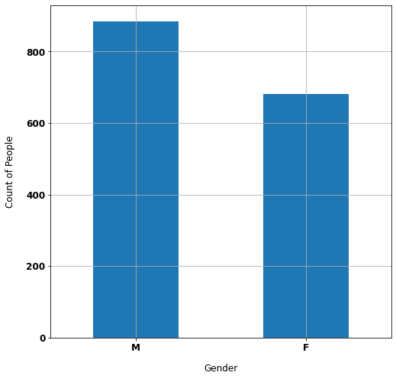
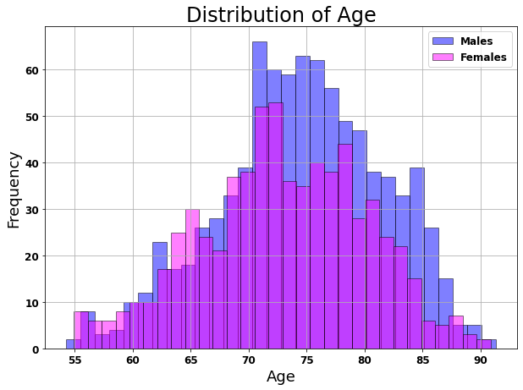
The ADNI Dataset (1)

Slide 5
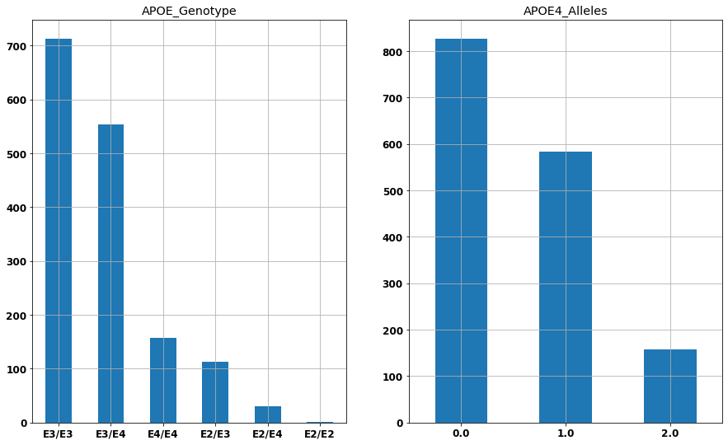
The ADNI Dataset (2)

Slide 6
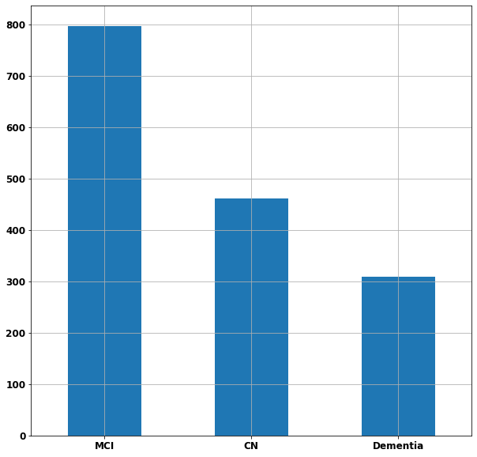
The ADNI Dataset (3)

Slide 7
Perform Linear Regression

Slide 8
Performing Linear Regression to remove Age, Sex, Brain Size effect
Age group chosen: 65-85
Fit to Cognitive Normals
Transform everyone in age group (CN, MCI, Dementia)

Slide 9
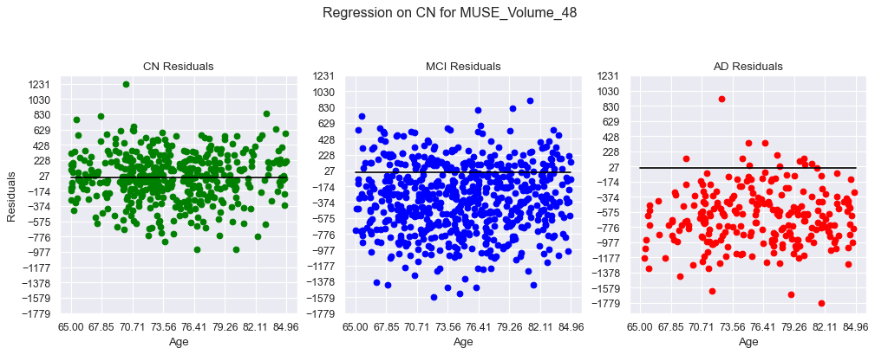
Linear Regression (1)

Slide 10
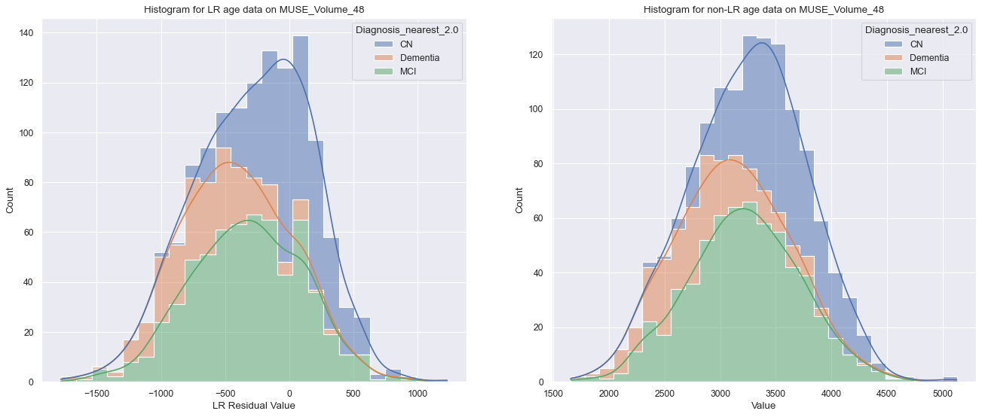
Linear Regression (2)

Slide 11
Use DCCA

Slide 12
Using DCCA (1)
Goal: Transform 2 views of the same dataset (e.g. Imaging - Genetic) into linearly correlated ones.
Method:
Use 2 separate Neural Networks
Perhaps different input size
Same Output size
Use CCA (linear) as loss metric (and backpropagate the loss to train the networks)
Pass the dataset (the 2 views) through the respective Networks, keep output as transformed features for next tasks (e.g. classification)

Slide 13
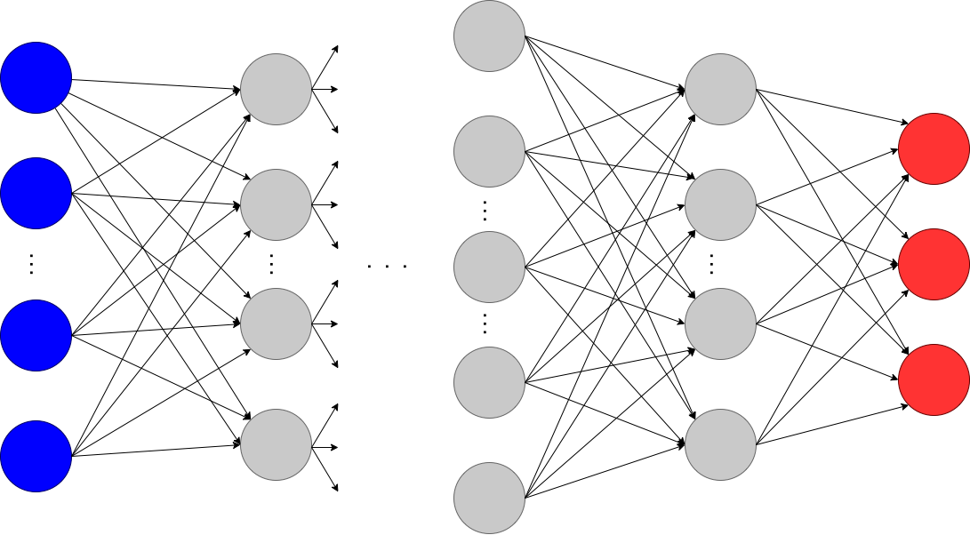
Hidden Layers
Output Layer
View 1:
Imaging Data
1st Neural Network:
145 ROIs -> 10 (150) Imaging Components
View 2:
Genetic Data
2nd Neural Network:
54 SNPs -> 10 (150) Genetic Components

Slide 14
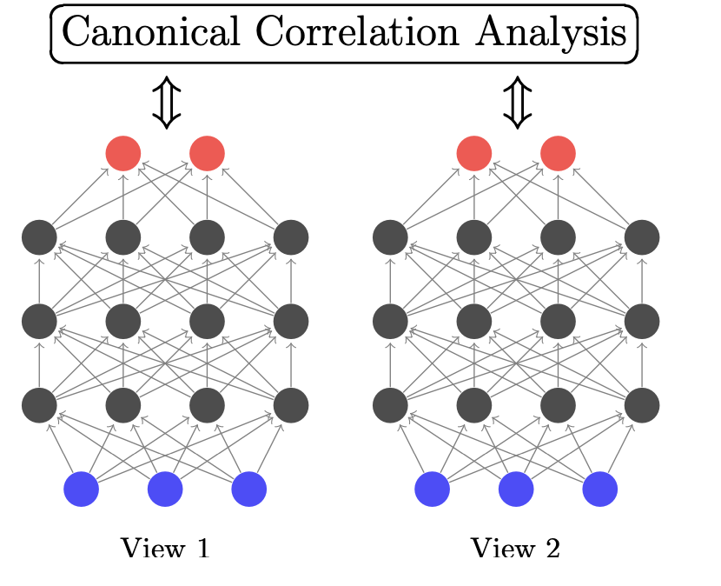
Using DCCA (2)
Normal CCA:
Find correlation between the blue data
Deep CCA:
Find correlation between the red (transformed) data

Slide 15
Using DCCA (3)
2 Views:
Imaging Data
Genetic Data
Play with parameters: (Use GridSearchCV)
Output layer dimensions
Number of Hidden Layers
Hidden Layer Size
Regularization
Learning Rate
Batching

Slide 16
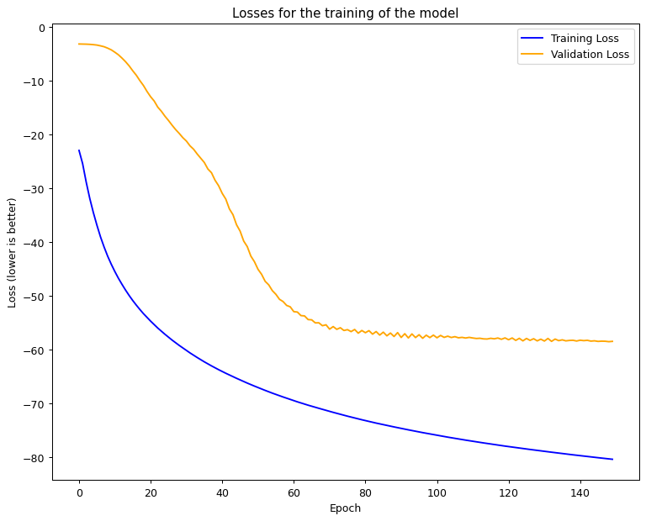
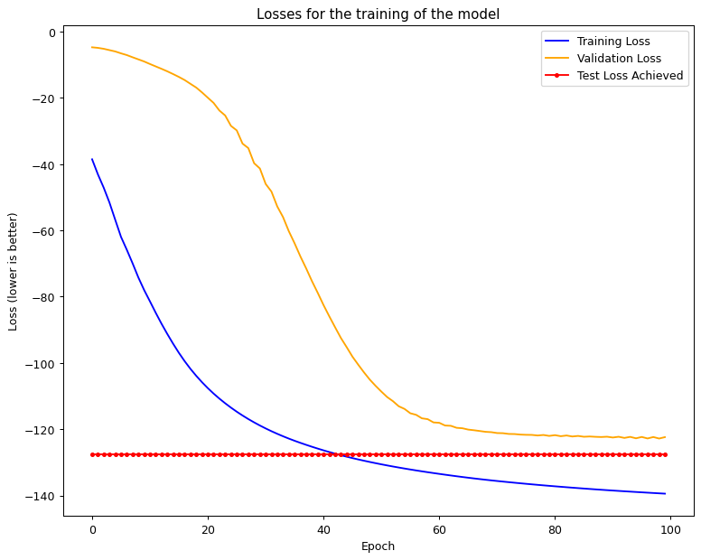
Performing DCCA (1)

Slide 17
Performing DCCA (2)
CCA on raw data:
Correlation = -1.225
CCA on DCCA NN output data:
Correlation = 0.139
Higher is better
1 is max (perfectly linearly correlated)
Can be negative (arbitrarily bad)

Slide 18
Performing DCCA (3)
The 2 Views are:
Genetic Data in the form of 54 SNPs
Imaging Data in the form of 145 ROIs
Use 145 ROI format
Can apply OPNMF and reduce to 30

Slide 19
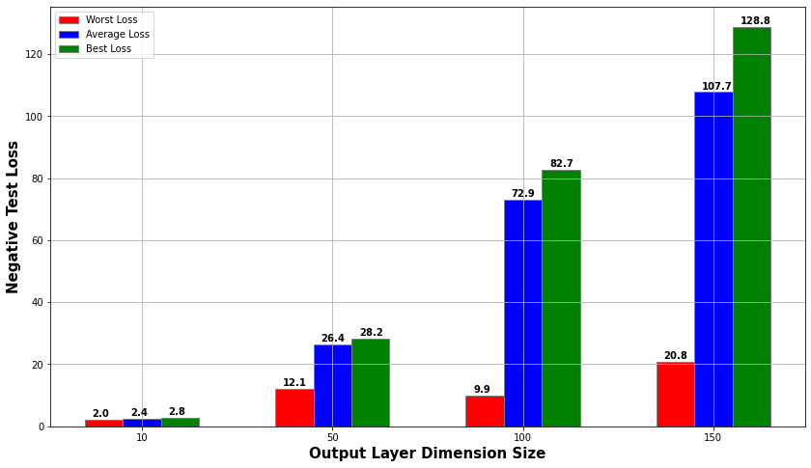
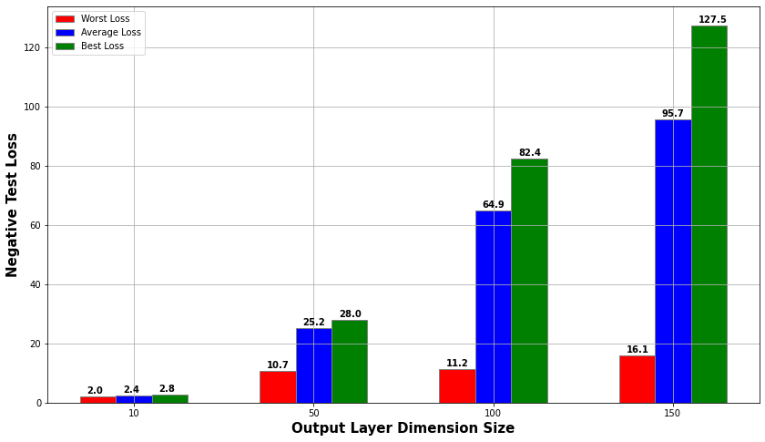
Analysing the DCCA Results (1)
145 ROI vs 30 through OPNMF based on Output Layer Size

Slide 20
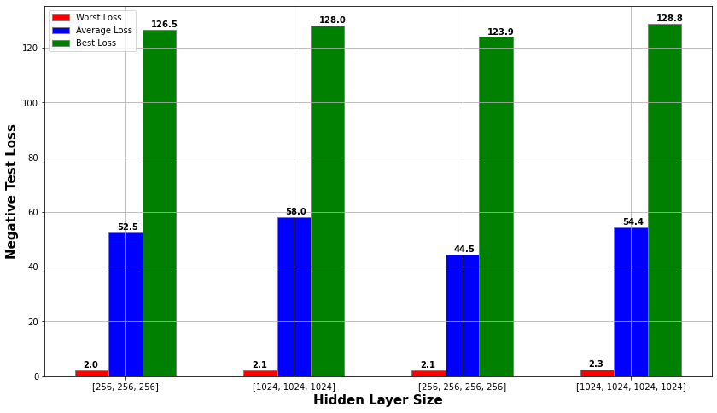
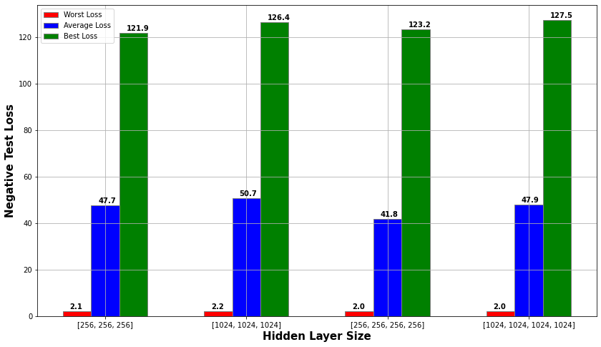
Analysing the DCCA Results (2)
145 ROI vs 30 through OPNMF based on Hidden Layers

Slide 21
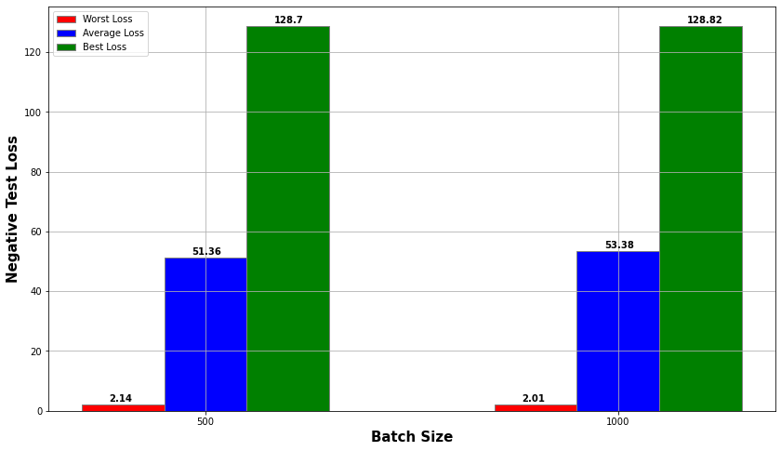
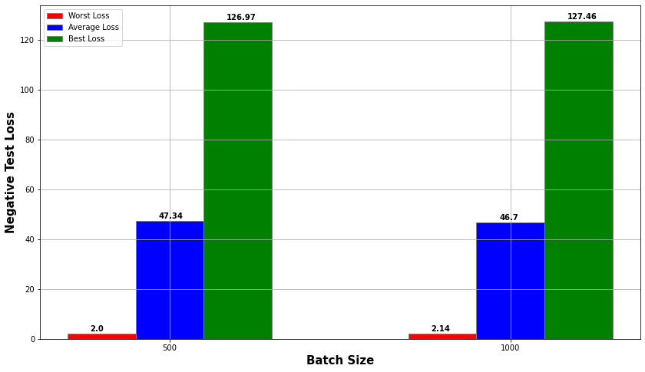
Analysing the DCCA Results (3)
145 ROI vs 30 through OPNMF based on Batch Size

Slide 22
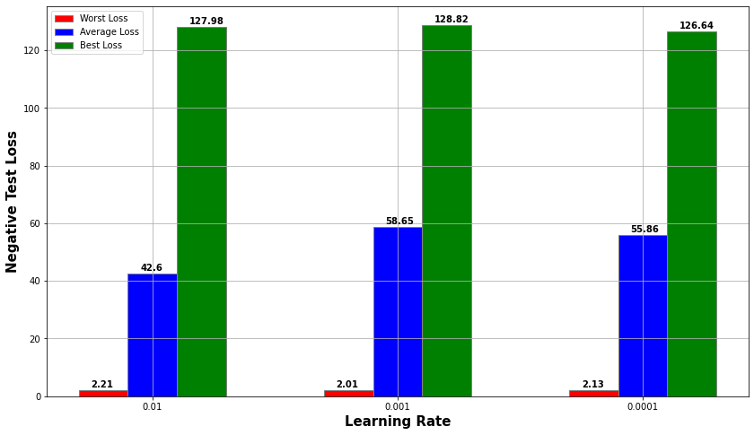
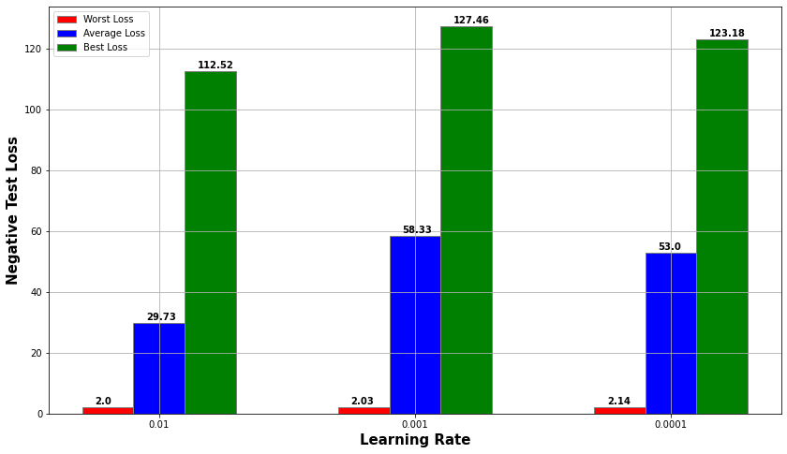
Analysing the DCCA Results (4)
145 ROI vs 30 through OPNMF based on Learning Rate

Slide 23
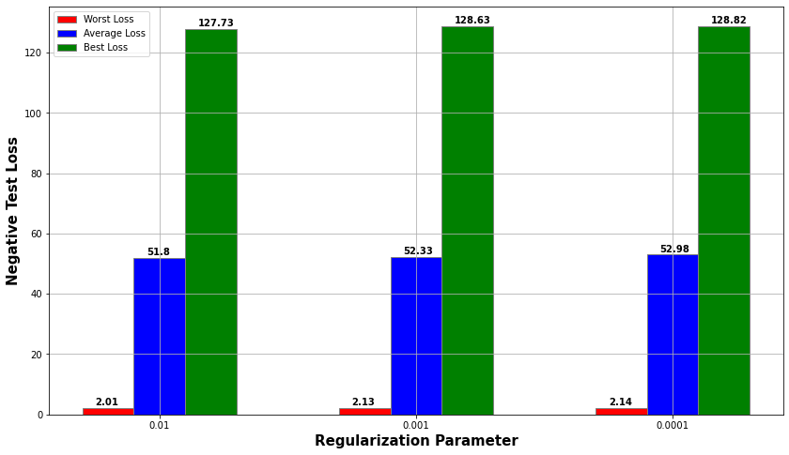
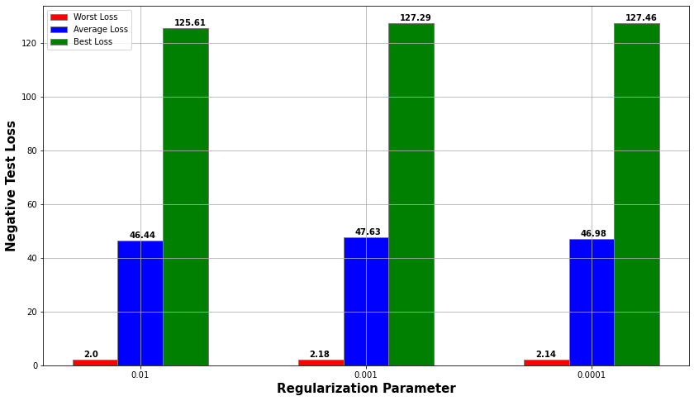
Analysing the DCCA Results (5)
145 ROI vs 30 through OPNMF based on Batch Size

Slide 24
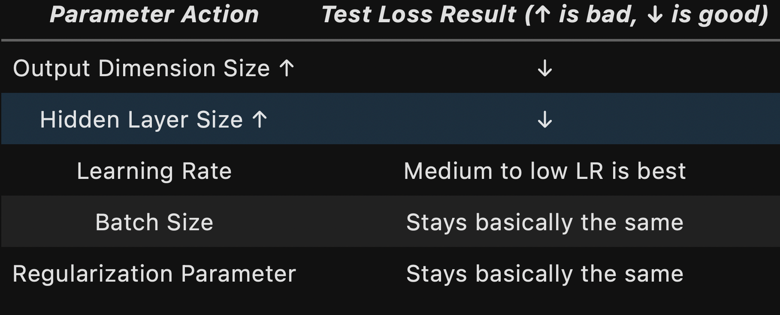
DCCA Training Conclusions

Slide 25
Classification

Slide 26
Classification using SVM
Play around with:
Kernel (Linear, Poly, RBF)
Iterations
Coefficients and gamma params
Regularisation
Use GridSearch
Use Cross Validation (5 Folds)

Slide 27
Accuracy
Accuracy = (TP + TN) / (TP+FP+TN+FN)
F1 score = 2*(Precision*Recall)/(Precision + Recall)
Balanced Accuracy = (Sensitivity + Specificity)/2 =
= Avg[TP/(TP + FN) + TN/(TN+FP)]

Slide 28
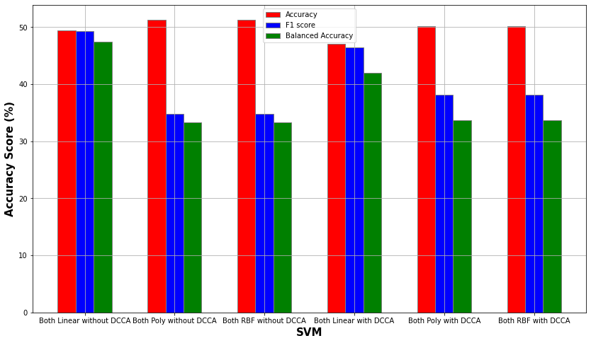
Classification using DCCA with 145 ROI (1)

Slide 29
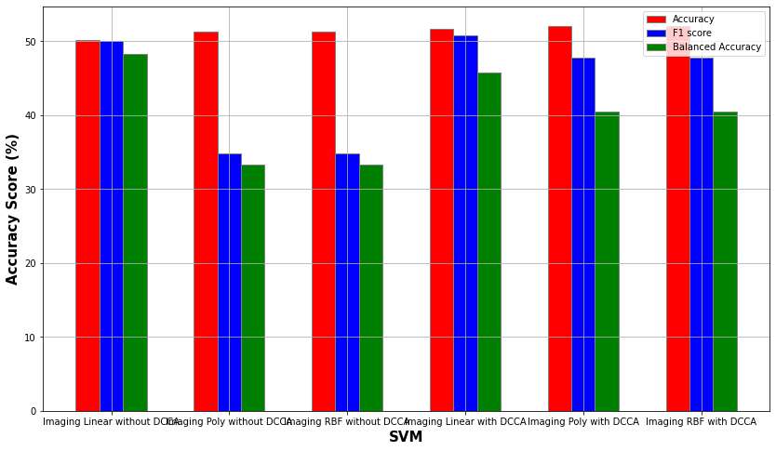
Classification using DCCA with 145 ROI (2)

Slide 30
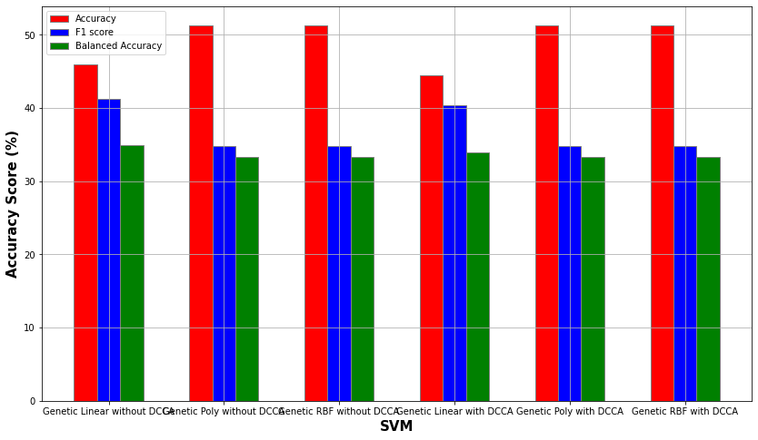
Classification using DCCA with 145 ROI (3)

Slide 31
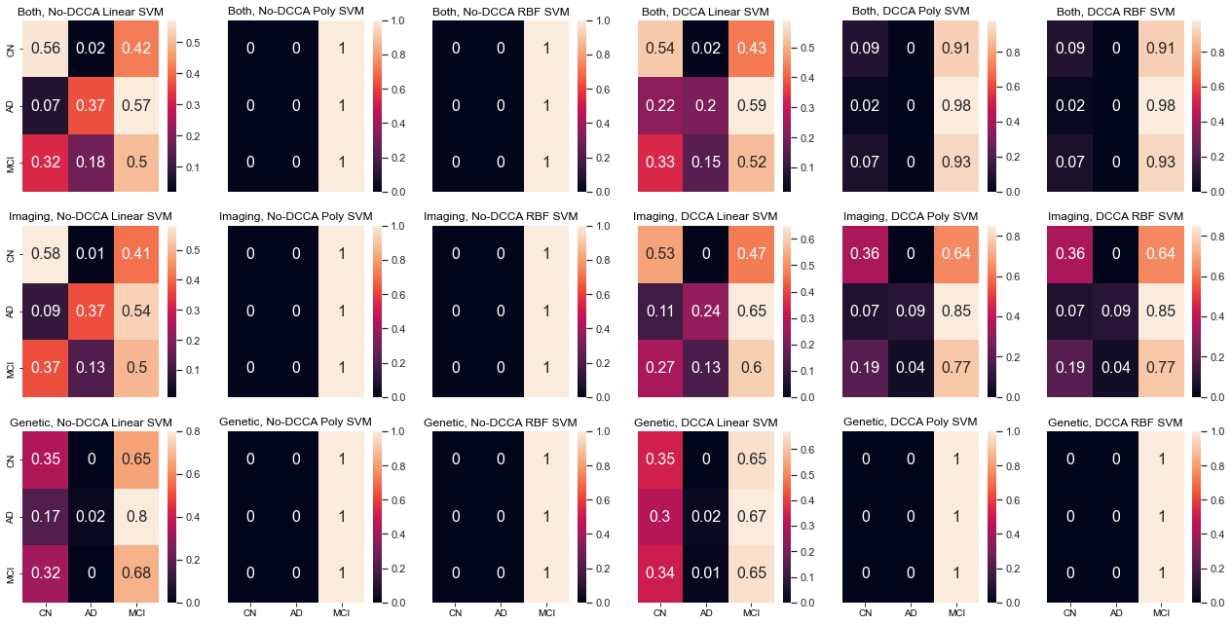
Classification using DCCA with 145 ROI (4)

Slide 32
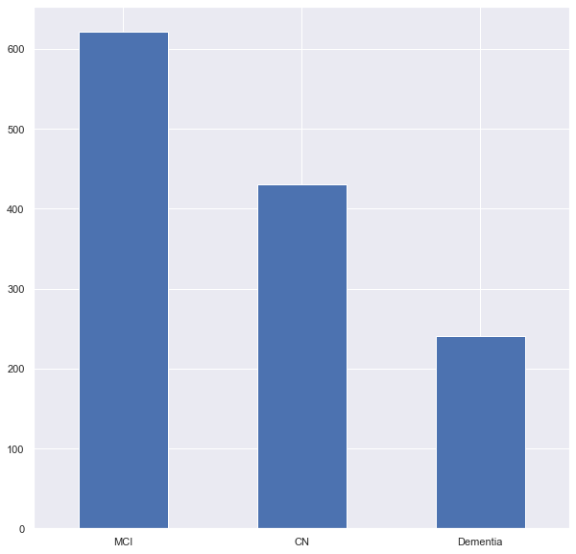
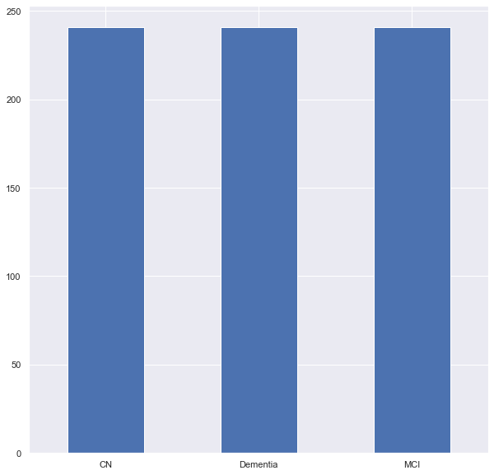
Using Scaling and Balancing (1)
Use random UnderSampling
Use Standard Scaling (not on Genetic data)
Sample Size:
1302 -> 723

Slide 33
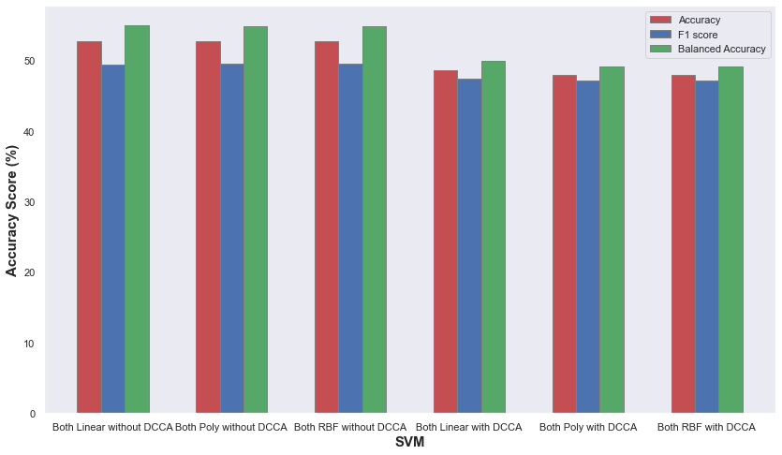
Using Scaling and Balancing (2)

Slide 34
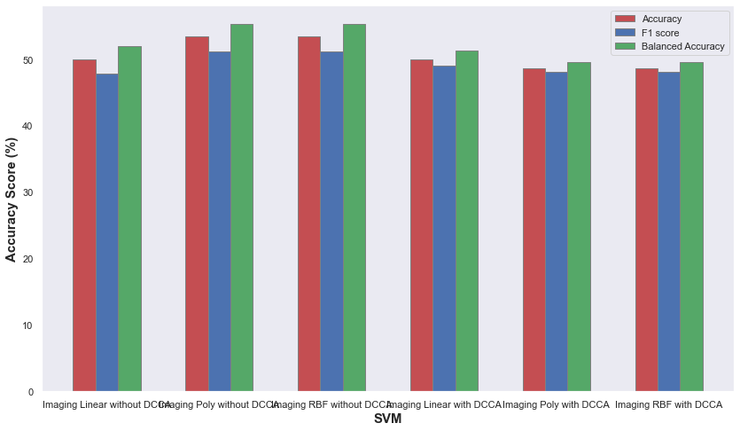
Using Scaling and Balancing (3)

Slide 35
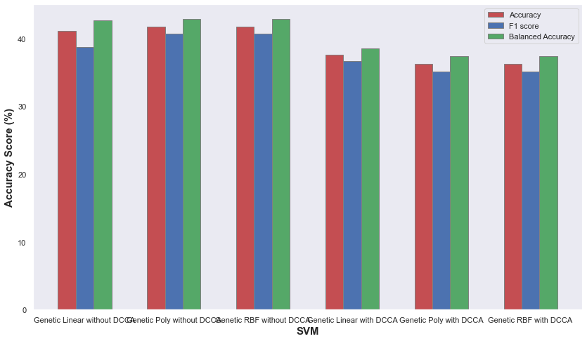
Using Scaling and Balancing (4)

Slide 36
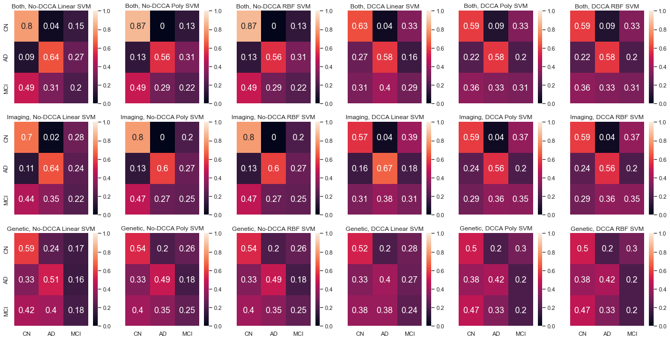
Using Scaling and Balancing (5)

Slide 37
Initial Conclusions
Model with max Accuracy: Imaging Poly no DCCA (Accuracy = 53.42 %)
Model with max F1 score : Imaging Poly no DCCA (F1 Score = 55.30 %)
Model with max Bal. Accu: Imaging Poly no DCCA (Bal. Accu = 51.12 %)
Better without DCCA than with!
Balancing and Scaling definitely helps!
Confusion Matrices show that AD / CN Classification is good!!

Slide 38
Experiment with data analysis techniques
Use OPNMF before DCCA

Slide 39
What is OPNMF
Orthogonal Projective Non-Negative Matrix Factorization
Goal is to dimensionally reduce data
Approach the Array with a multiplication of non-negative arrays
Minimize the approximation error
Orthogonal Projective NMF: require that H^{T}H = I.

Slide 40
OPNMF - DCCA Training Conclusions
Same as before

Slide 41
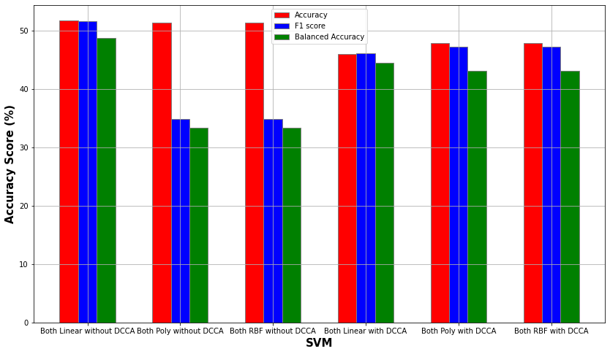
Classification using OPNMF DCCA (1)

Slide 42
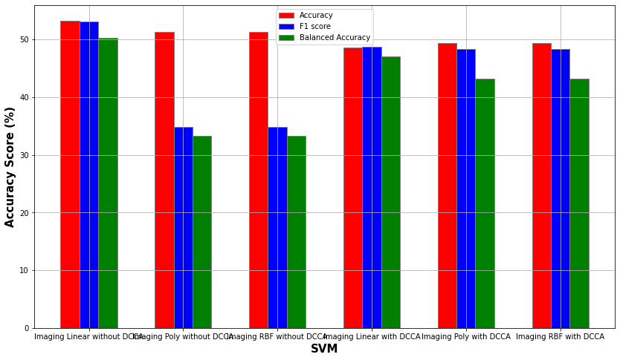
Classification using OPNMF DCCA (2)

Slide 43
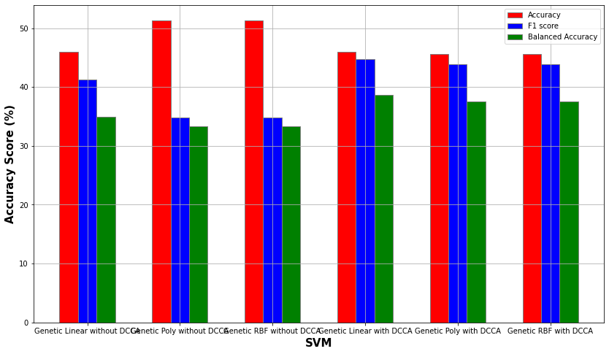
Classification using OPNMF DCCA (3)

Slide 44
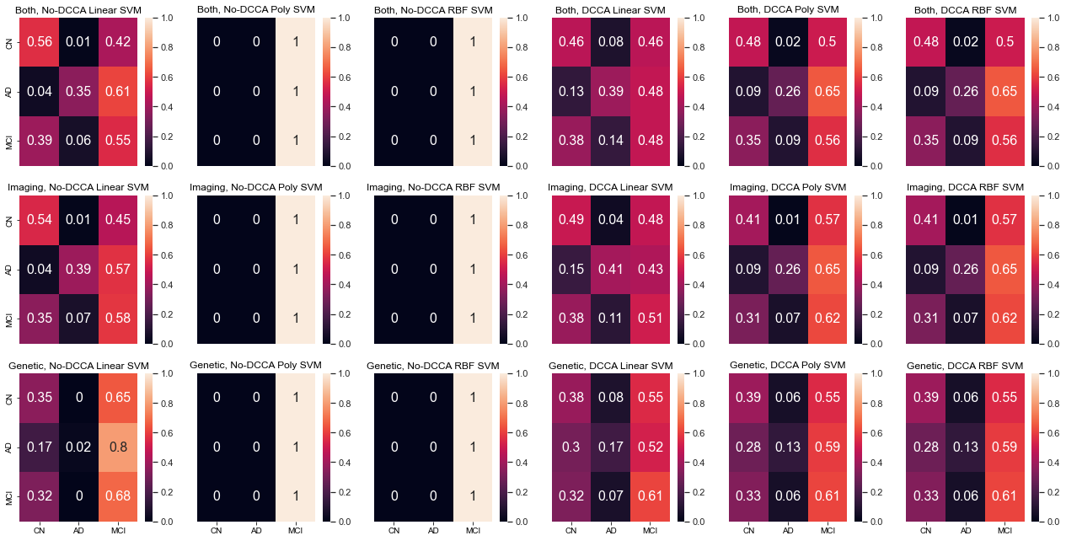
Classification using OPNMF DCCA (4)

Slide 45
Using Scaling and Balancing (1)
Use random UnderSampling
Use Standard Scaling (not on Genetic data)
Sample Size:
1294 -> 723

Slide 46
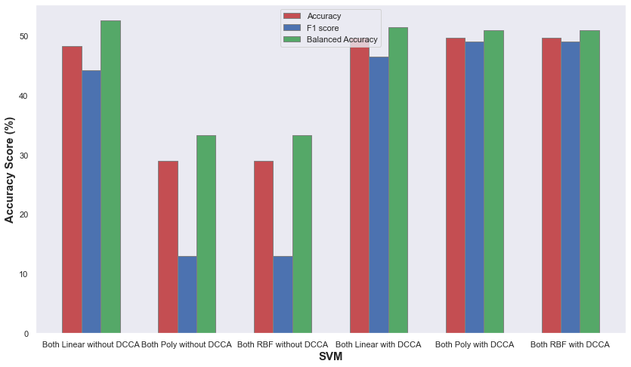
Using Scaling and Balancing (2)

Slide 47
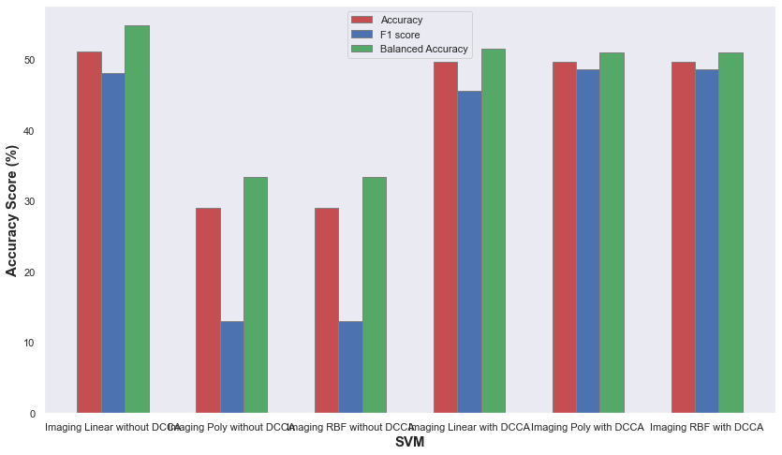
Using Scaling and Balancing (3)

Slide 48
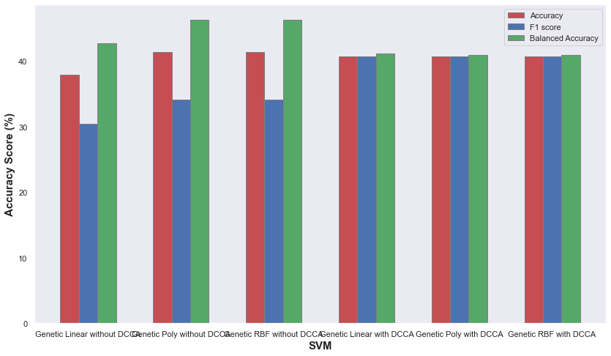
Using Scaling and Balancing (4)

Slide 49
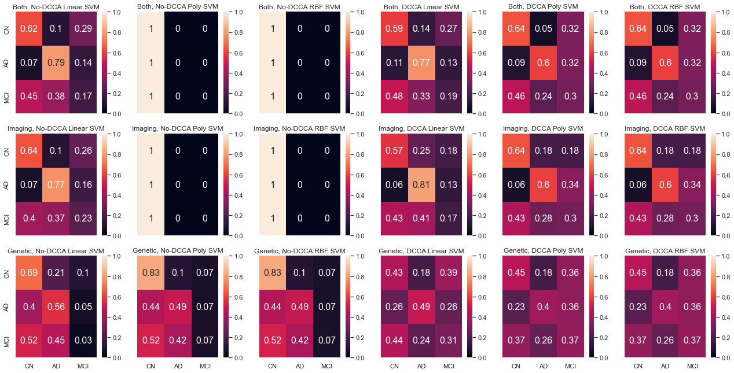
Using Scaling and Balancing (5)

Slide 50
OPNMF - DCCA Conclusions
Model with max Accuracy: Imaging Linear no DCCA (Accuracy = 51.03 %)
Model with max F1 score : Both Poly With DCCA (F1 Score = 49.03 %)
Model with max Bal. Accu: Imaging Linear no DCCA (Bal. Accu = 54.78 %)
Imaging only seems to be a bit better than using both views
Better without DCCA than with! (Again)
Balancing and Scaling helps! (Again)
Confusion Matrices show that AD / CN Classification is good! (Again)
DCCA with OPNMF produces slightly better results than vanilla DCCA

Slide 51
Experiment with data analysis techniques
Use MCA before DCCA

Slide 52
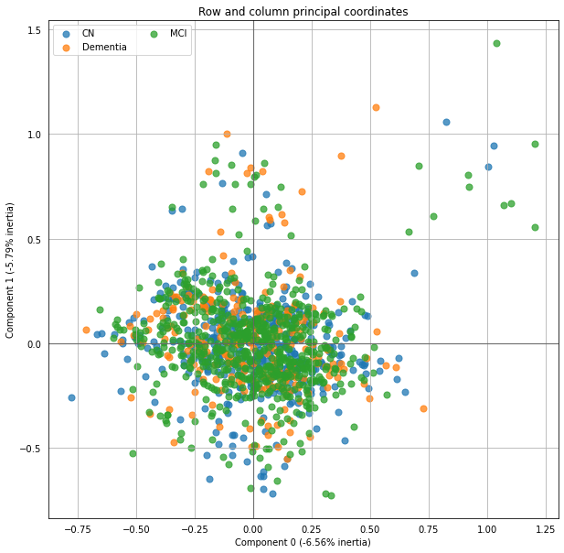
What is MCA
Multiple Correspondence Analysis
Data Analysis Technique for categorical data (i.e. “A” / “B” / “C” or “True” / “False”)
Similar to Principal Component Analysis
Use on Genetic Data that have “0” or “1” or “2”

Slide 53
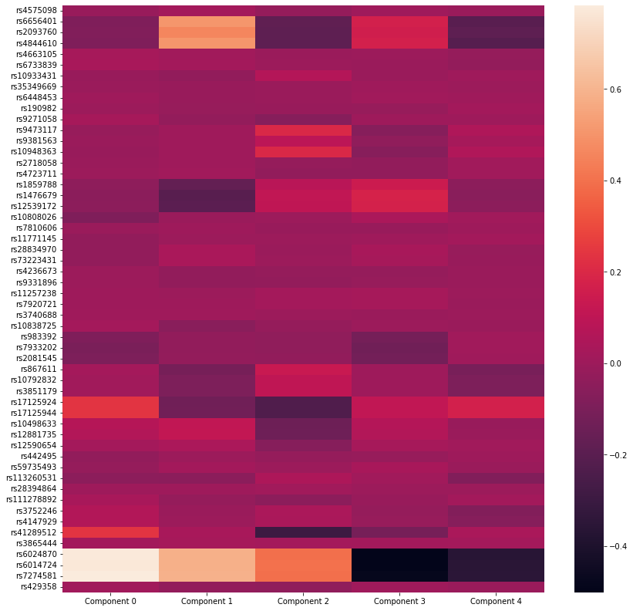
MCA Example

Slide 54
MCA - DCCA Training Conclusions
Same as before

Slide 55
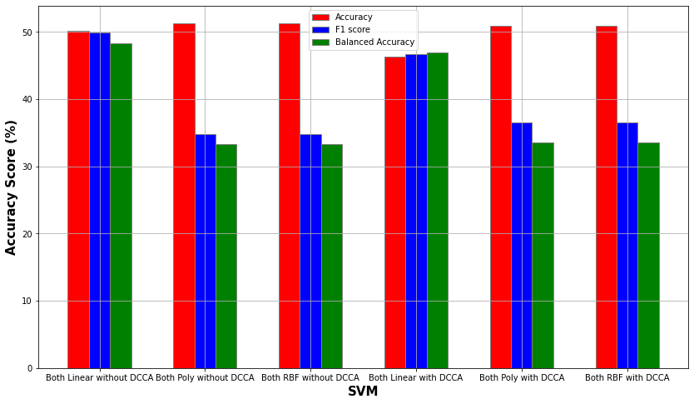
Classification using MCA DCCA(1)

Slide 56
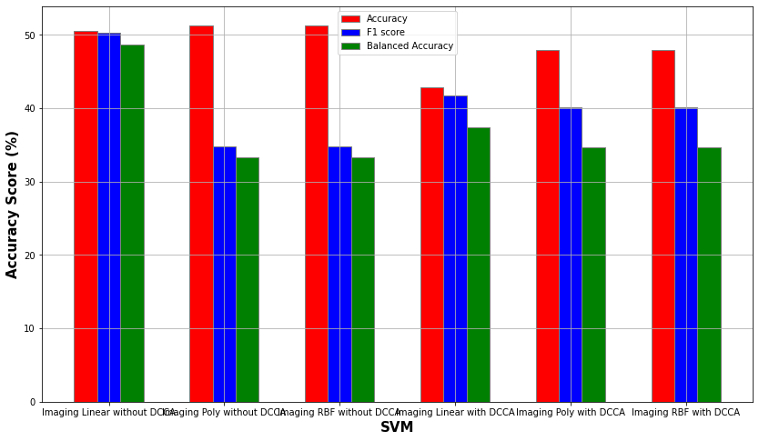
Classification using MCA DCCA (2)

Slide 57
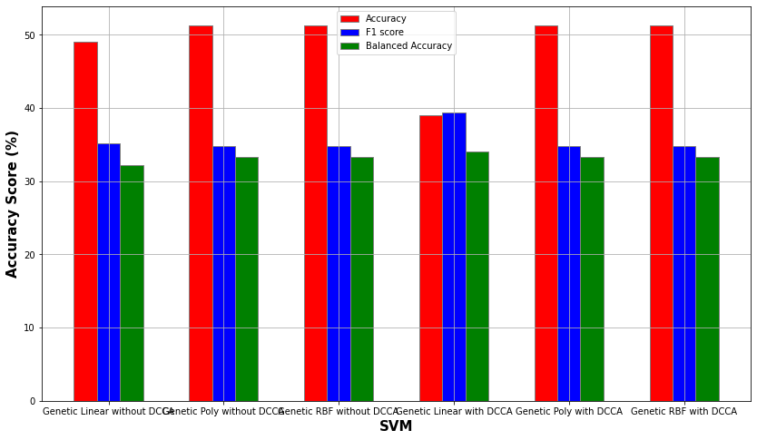
Classification using MCA DCCA (3)

Slide 58
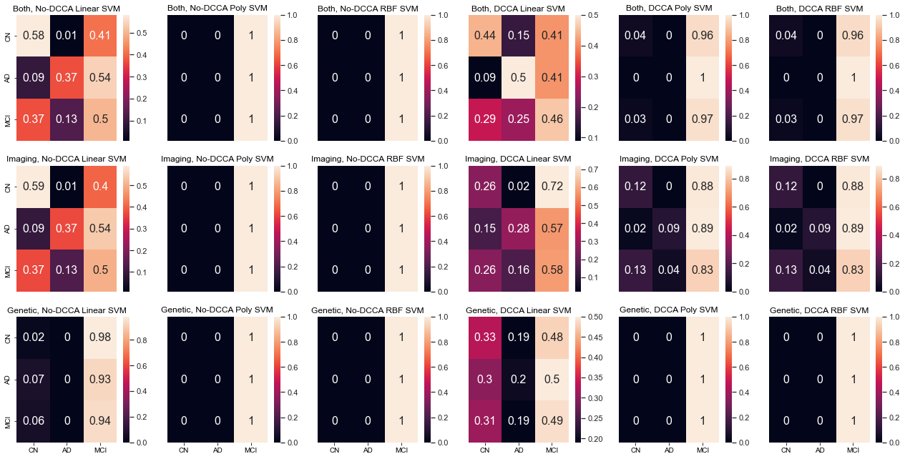
Classification using MCA DCCA (4)

Slide 59
Using Scaling and Balancing (1)
Use random UnderSampling
Use Standard Scaling (not on Genetic data)
Sample Size:
1294 -> 723

Slide 60
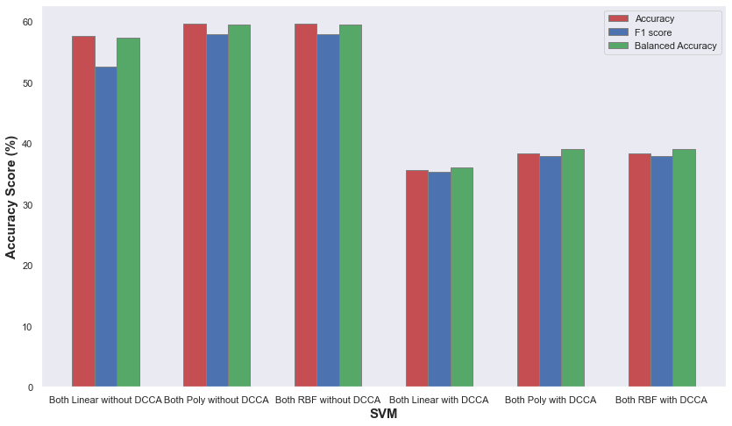
Using Scaling and Balancing (2)

Slide 61
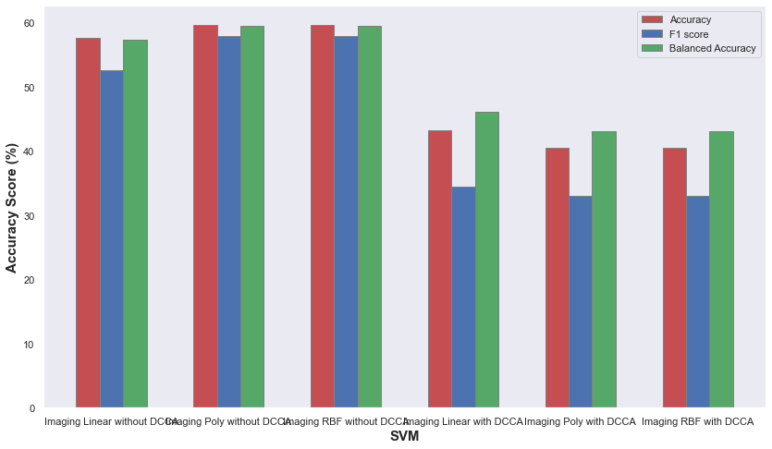
Using Scaling and Balancing (3)

Slide 62
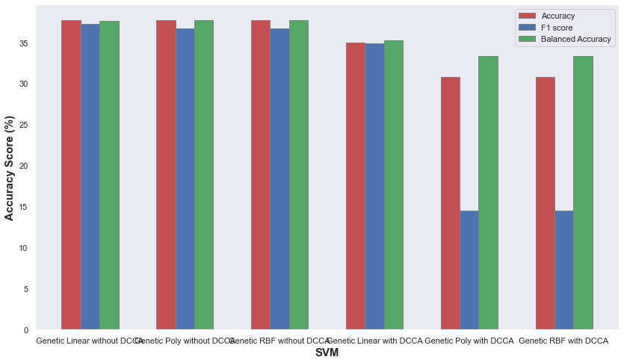
Using Scaling and Balancing (4)

Slide 63
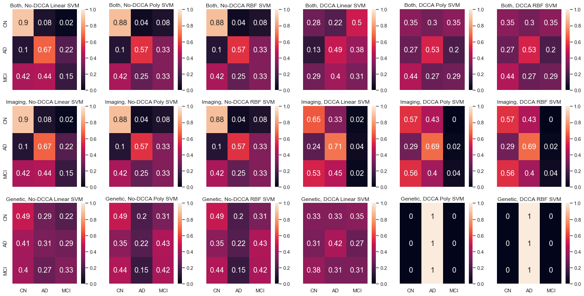
Using Scaling and Balancing (5)

Slide 64
MCA - DCCA Conclusions
Model with max Accuracy: Both Poly without DCCA (Accuracy = 59.59 %)
Model with max F1 score : Both Poly without DCCA (F1 Score = 57.85 %)
Model with max Bal. Accu: Both Poly without DCCA (Bal. Accu = 59.41 %)
Highest scores yet!!
Scaling and balancing is crucial
DCCA doesn’t produce better results
Really good Confusion Matrices

Slide 65
Experiment with data analysis techniques
Use MCA and OPNMF

Slide 66
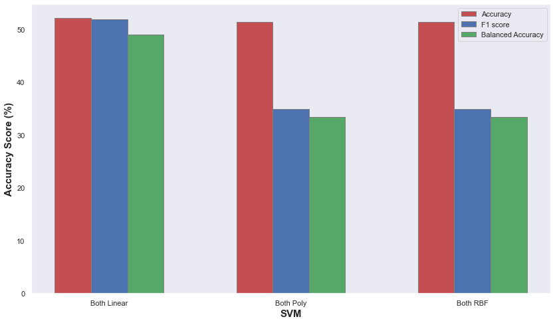
Classification using MCA & OPNMF (1)

Slide 67

Classification using MCA & OPNMF (2)

Slide 68
Using Scaling and Balancing (1)
Use random UnderSampling
Use Standard Scaling (not on Genetic data)
Sample Size:
1294 -> 723

Slide 69

Using Scaling and Balancing (2)

Slide 70

Using Scaling and Balancing (3)

Slide 71
MCA & OPNMF Conclusions
Model with max Accuracy: Both Linear (Accuracy = 56,55 %)
Model with max F1 score : Both Linear (F1 Score = 53,78 %)
Model with max Bal. Accu: Both Linear (Bal. Accu = 58,18 %)
Scaling and Balancing really help, especially Poly and RBF kernels
Confusion Matrices really encouraging as well
Worse Scores than only MCA, but still very good results!!

Slide 72
Experiment with data analysis techniques
Use FAMD before DCCA

Slide 73

What is FAMD
Factor Analysis of Mixed Data
Data Analysis Technique for mixed data (i.e. both “A” / “B” / “C” or “True” / “False” and [0, 15.5, …] -> numerical)
Essentially PCA for numerical & MCA for categorical
Use on Genetic Data that take values from [“0”,“1”,“2”] and Imaging Data that take real values

Slide 74

Classification using FAMD (1)
Accuracy: 55.17%
F1 score: 52.05%
Balanced Accuracy:
45.81%

Slide 75

Classification using FAMD (2)

Slide 76
Using Scaling and Balancing (1)
Use random UnderSampling
Use Standard Scaling (not on Genetic data)
Sample Size:
1294 -> 723

Slide 77

Using Scaling and Balancing (2)
Accuracy: 51.37%
F1 score: 45.71%
Balanced Accuracy:
53.88%

Slide 78

Using Scaling and Balancing (3)

Slide 79
FAMD Conclusions
Model with max Accuracy: Both Poly (Accuracy = 55.17 %) (UB, US)
Model with max F1 score : Both Linear (F1 Score = 52.46 %) (UB, US)
Model with max Bal. Accu: Both Linear (Bal. Accu = 53.88 %)
Scaling and Balancing help Balanced Accuracy, hurt other metrics
Confusion Matrices not really encouraging
Worse Balanced Accuracy than before

Slide 80

Results
Picking the best scores for each model:

Slide 81

Results
Picking the best scores for each model:

Slide 82
Conclusions
DCCA has generally more robust results (better F1, Balanced Accuracy Scores), if we factor in all models
DCCA has worse scores than no-DCCA
Both views with Linear SVM, after MCA is best.
2nd best is Both, Linear SVM, MCA, OPNMF.
Scaling is needed for 145 ROIs, not really for OPNMF.

Slide 83
Thank you

